Slide 1
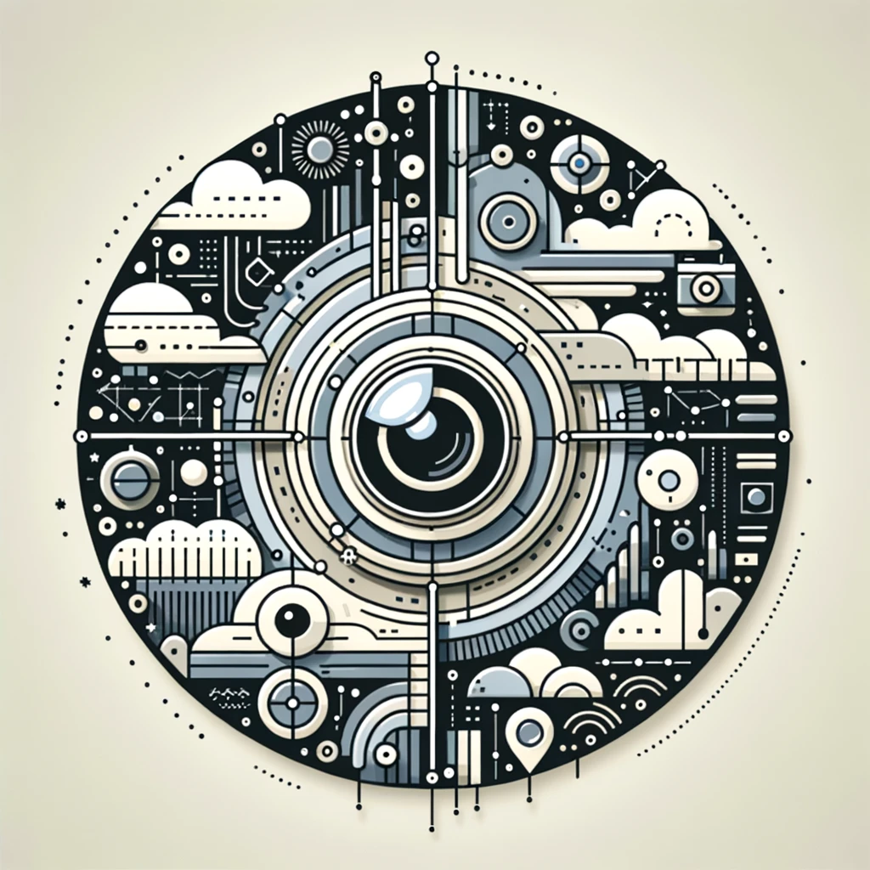
Binning anomaly detection
Idea presentation
Gibeom Kim (UST)

Slide 2
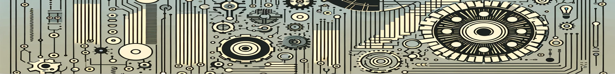
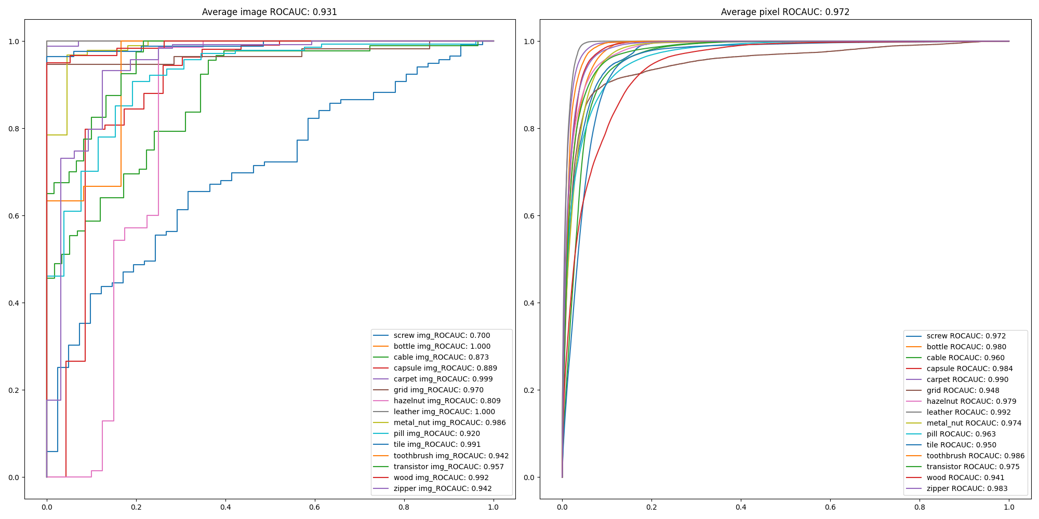
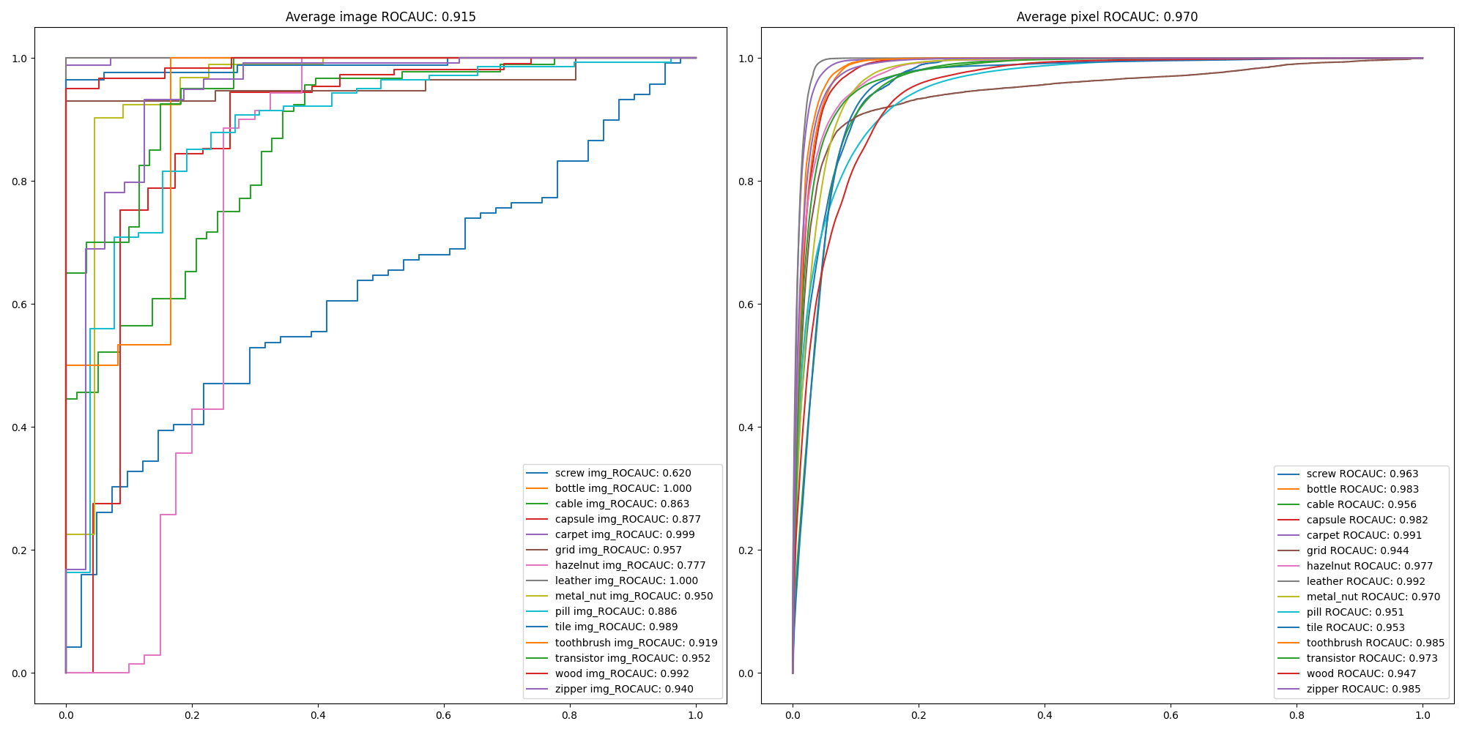
3. Result
Apply data augment (wide_resnet_50)

Slide 3
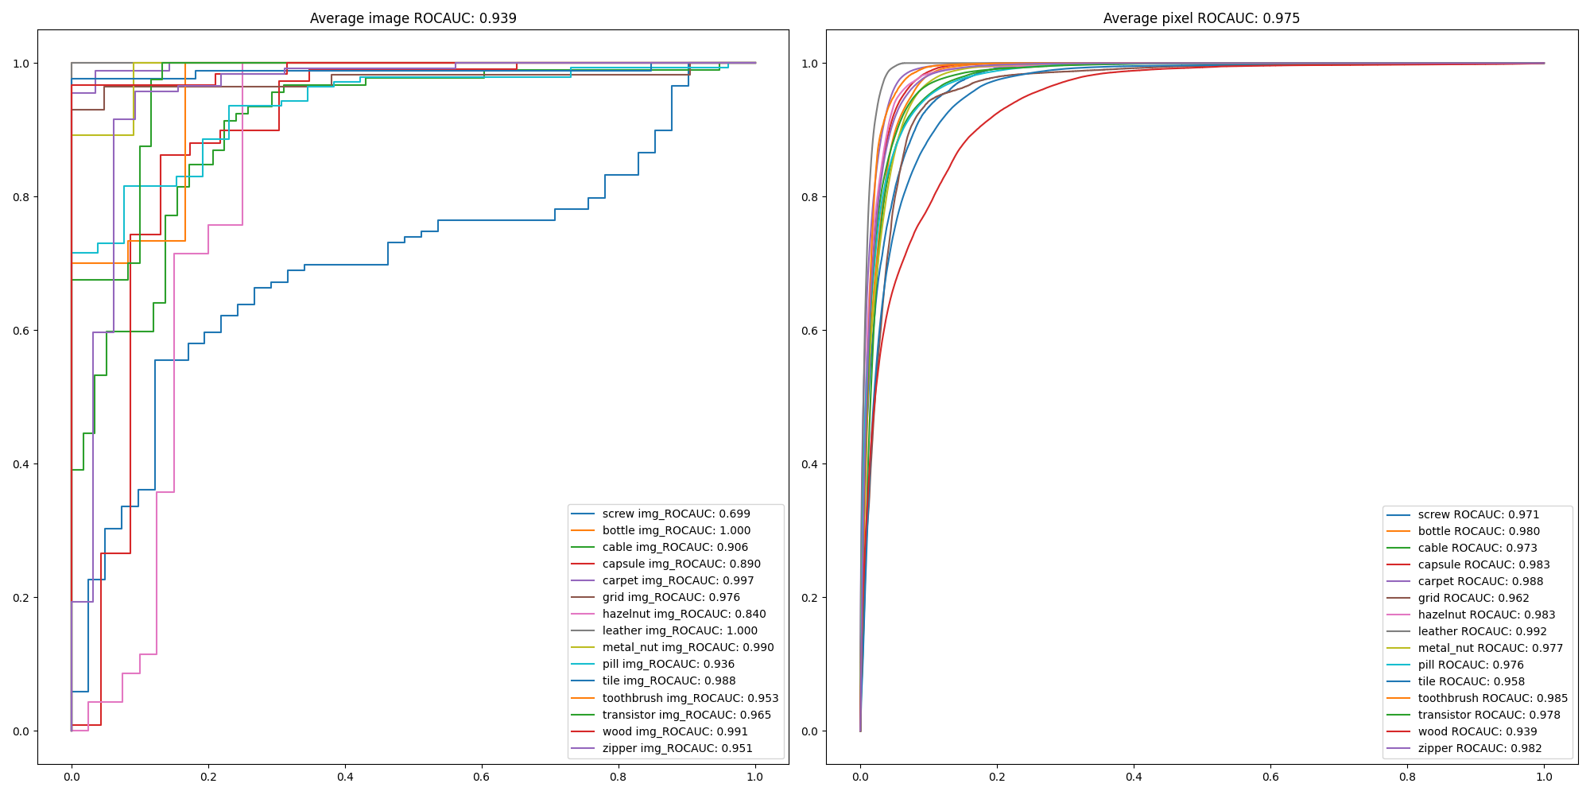
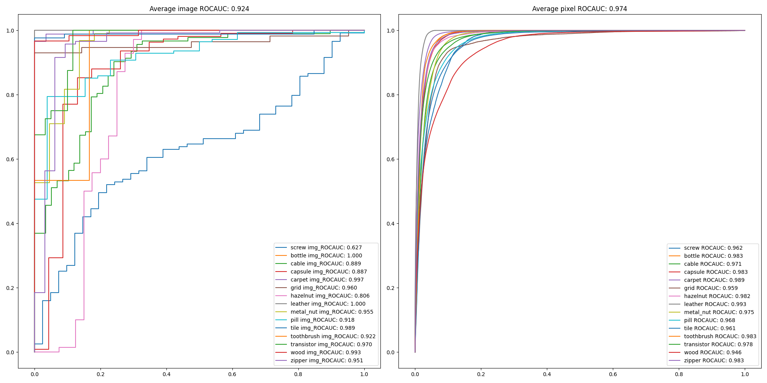
3. Result
Apply data augment (wide_resnet_101)

Slide 4
3. Result
Apply data augment
Class | Rotation angle | Applied mode | Augmentation
screw | 0° ~ 359° (1° offset) | cv2.BORDER_REPLICATE | Gamma, Gauss noise, ISO noise
bottle | 0° ~ 359° (1° offset) | cv2.BORDER_REPLICATE | Gamma, Gauss noise, ISO noise
cable | x | x | Gamma, Gauss noise, ISO noise
capsule | x | x | Gamma, Gauss noise, ISO noise
carpet | x | x | Gamma, Gauss noise, ISO noise
grid | 0° ~ 359° (1° offset) | cv2.BORDER_REFLECT | Gamma, Gauss noise, ISO noise
hazelnut | 0° ~ 359° (1° offset) | cv2.BORDER_REPLICATE | Gamma, Gauss noise, ISO noise
leather | 0° ~ 359° (1° offset) | cv2.BORDER_REFLECT | Gamma, Gauss noise, ISO noise
metal_nut | 0° ~ 359° (1° offset) | cv2.BORDER_REPLICATE | Gamma, Gauss noise, ISO noise
pill | x | x | Gamma, Gauss noise, ISO noise
tile | 0° ~ 359° (1° offset) | cv2.BORDER_REFLECT | Gamma, Gauss noise, ISO noise
toothbrush | x | x | Gamma, Gauss noise, ISO noise
transistor | x | x | Gamma, Gauss noise, ISO noise
wood | x | x | Gamma, Gauss noise, ISO noise
zipper | x | x | Gamma, Gauss noise, ISO noise
ground_truth | 0° ~ 359° (1° offset) | cv2.BORDER_REPLICATE | Rotate only

Slide 5
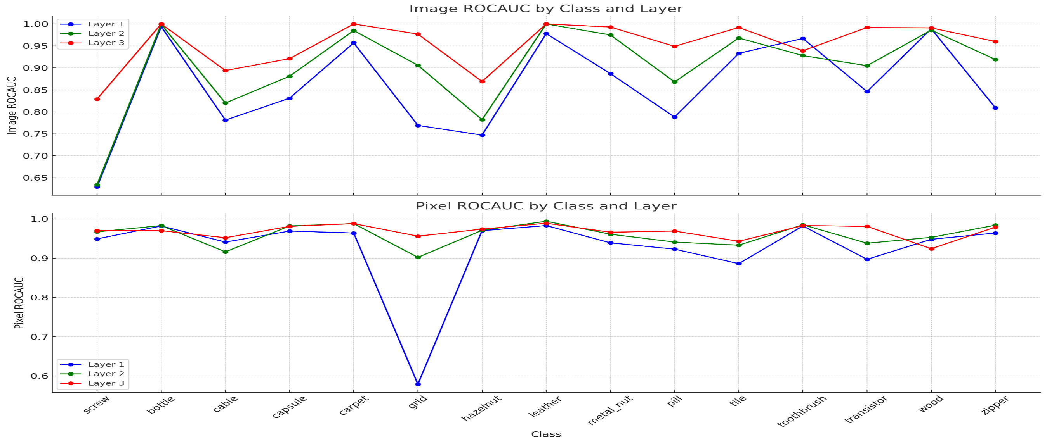
3. Result
Accuracy check for each layer output

Slide 6
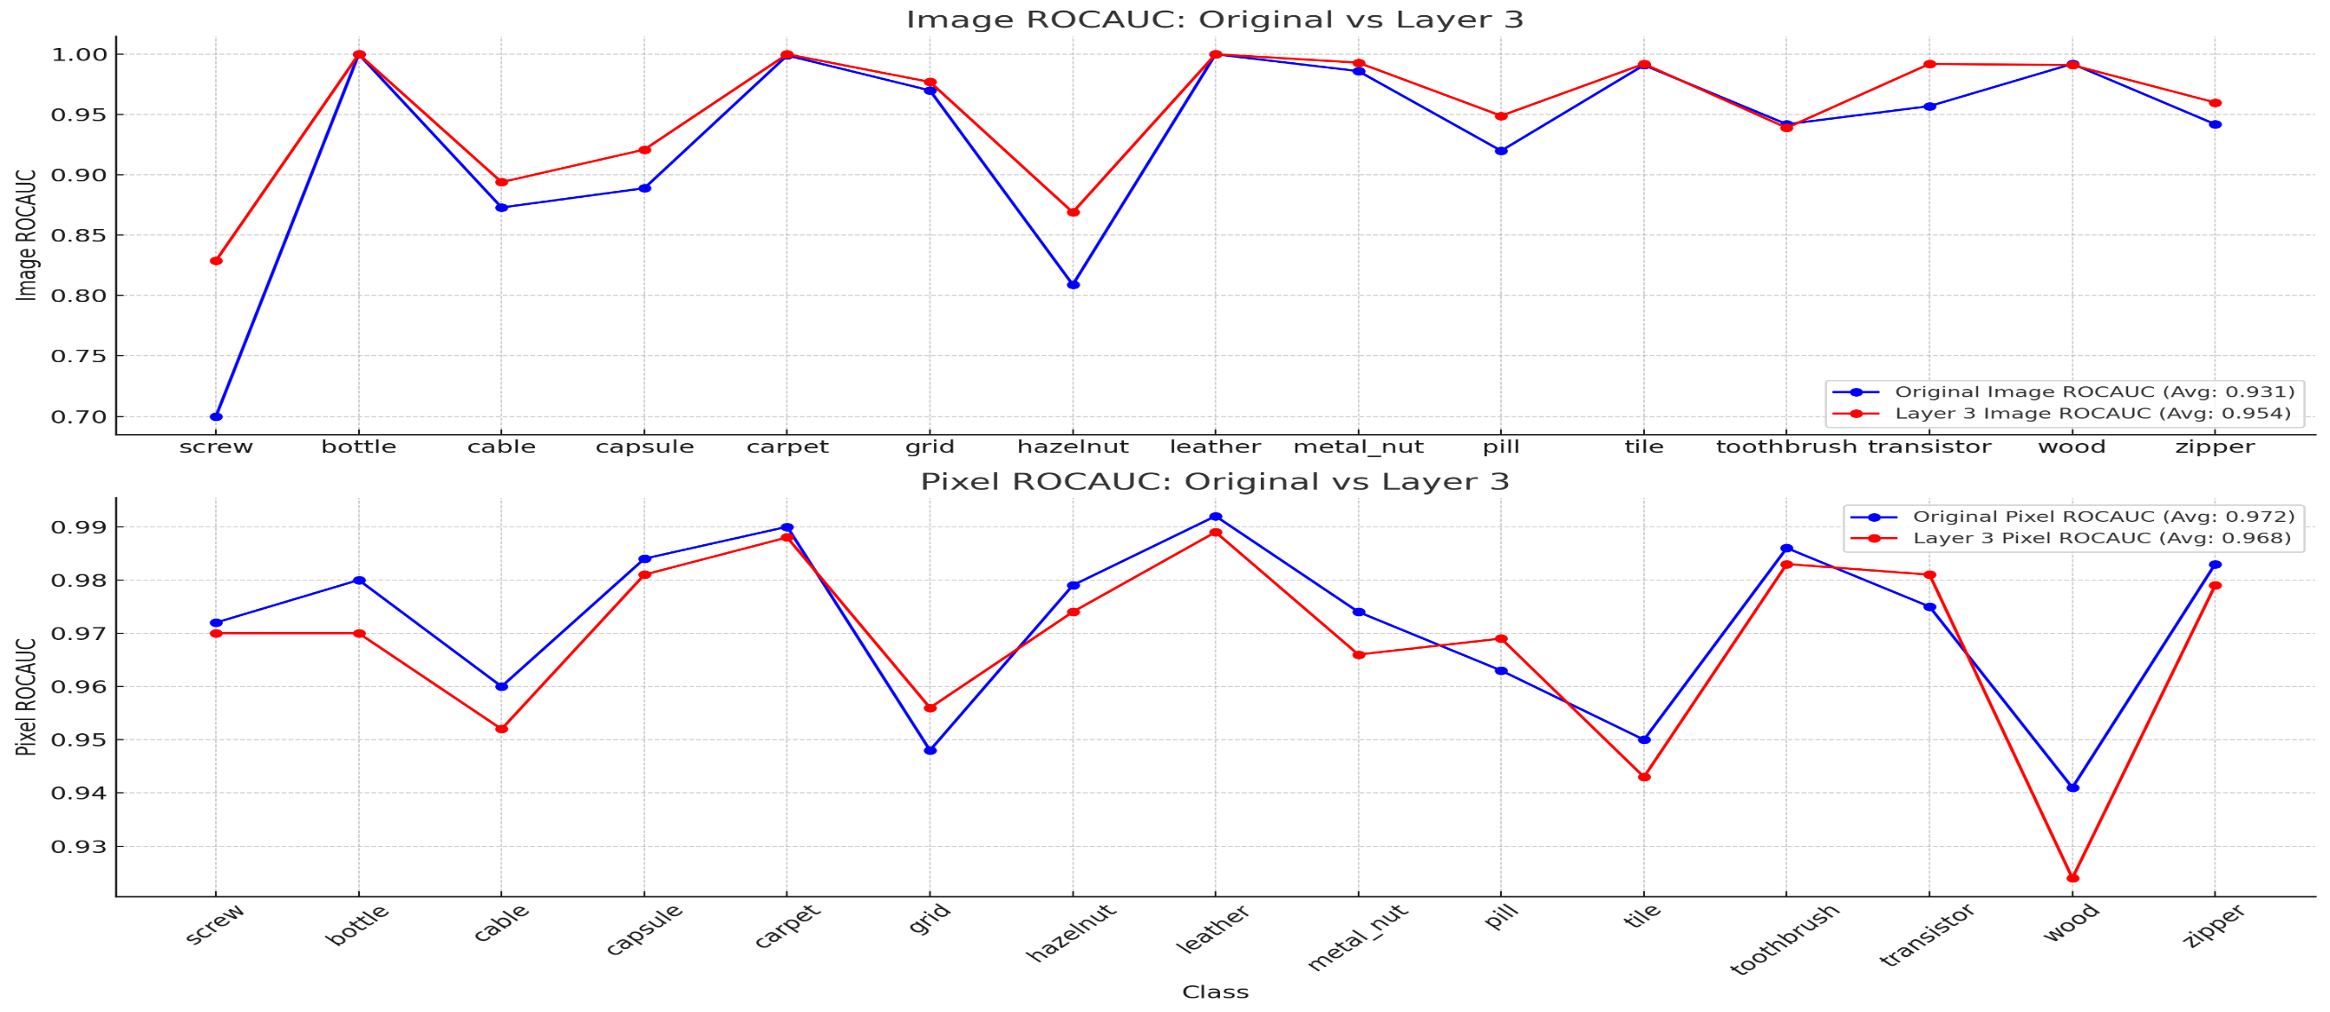
3. Result
Accuracy check for each layer output

Slide 7
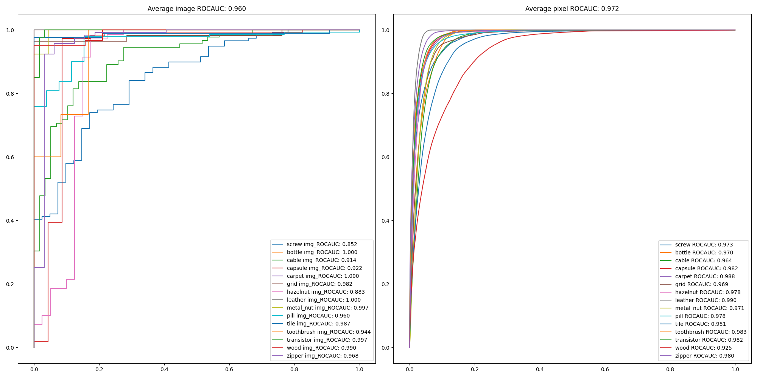
3. Result
Combine architecture(wide_resnet_101, wide_resnet_50)

Slide 8
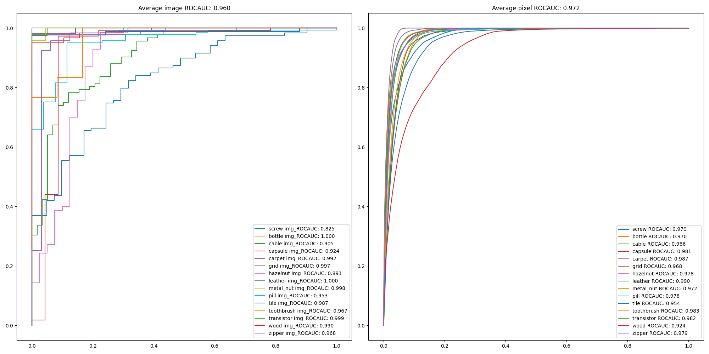
3. Result
Combine architecture(wide_resnet_101, resnet_101)

Slide 9
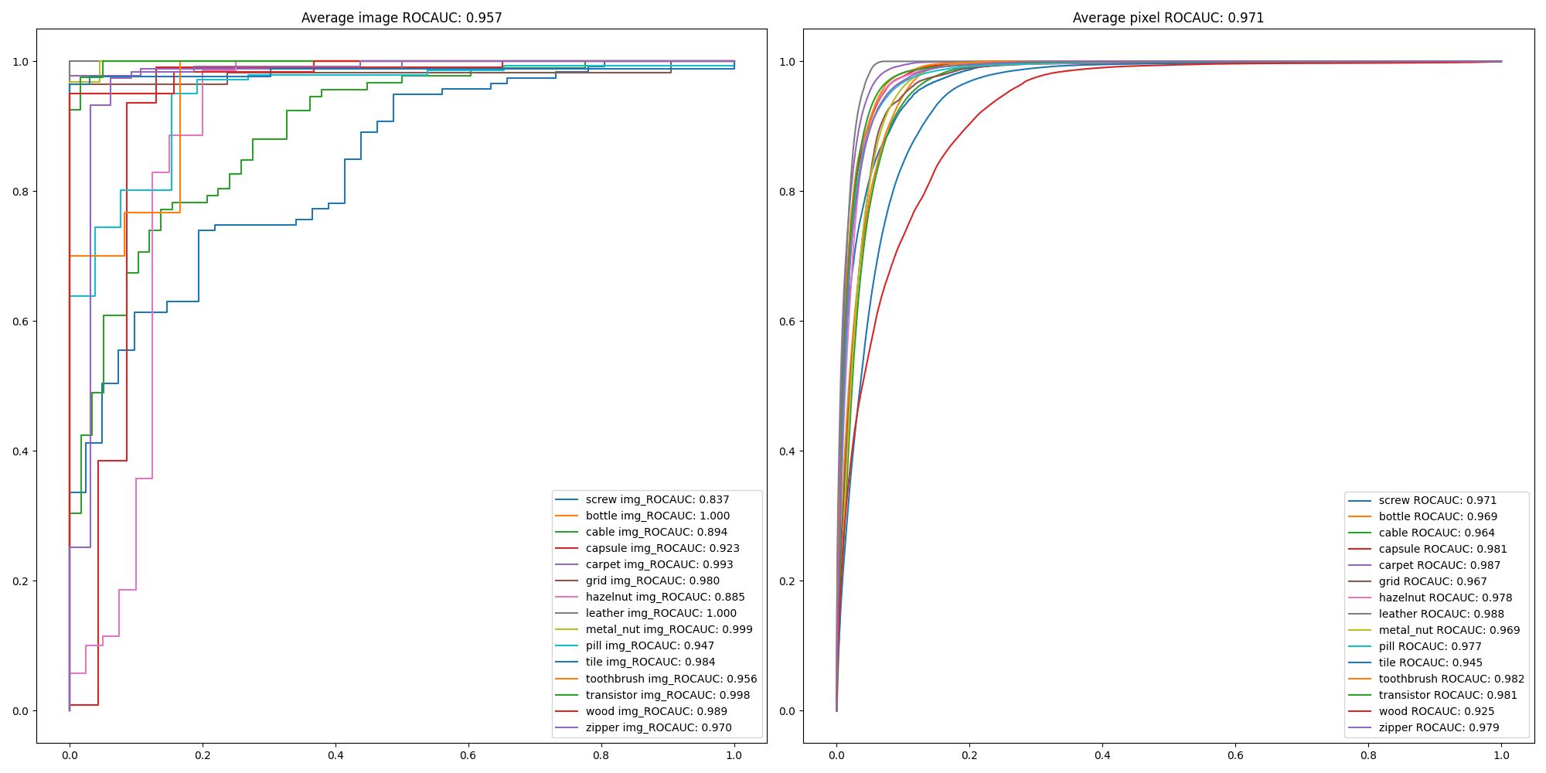
3. Result
Combine architecture(wide_resnet_101, resnet_50)

Slide 10
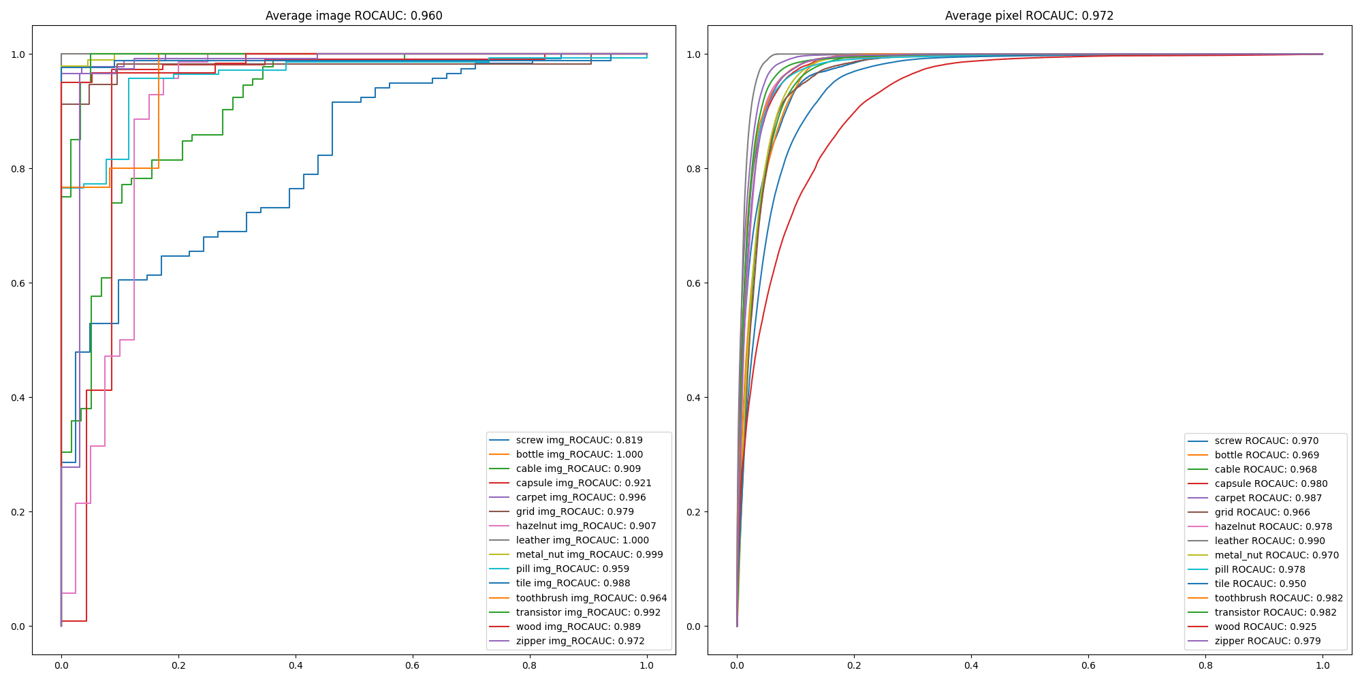
3. Result
Combine architecture(wide_resnet_101, resnet_18)

Slide 11
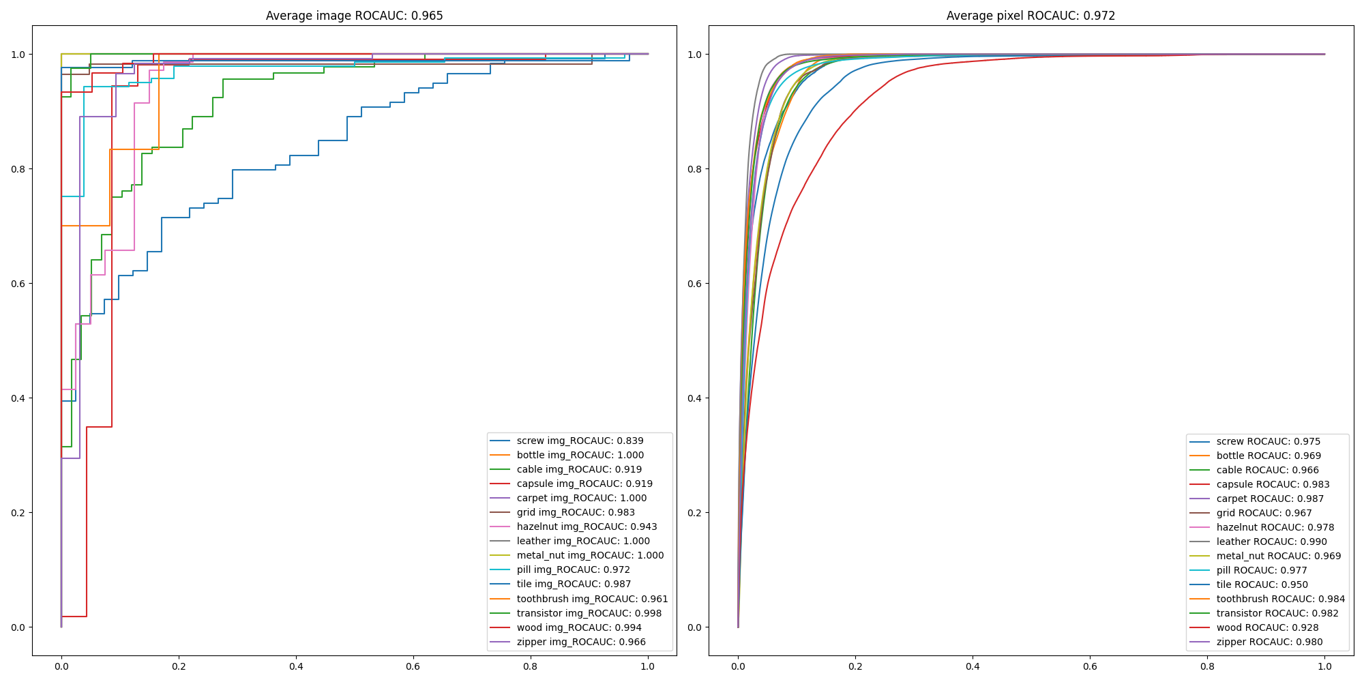
3. Result
Combine architecture(wide_resnet_101, resnext101_32x8d)

Slide 12
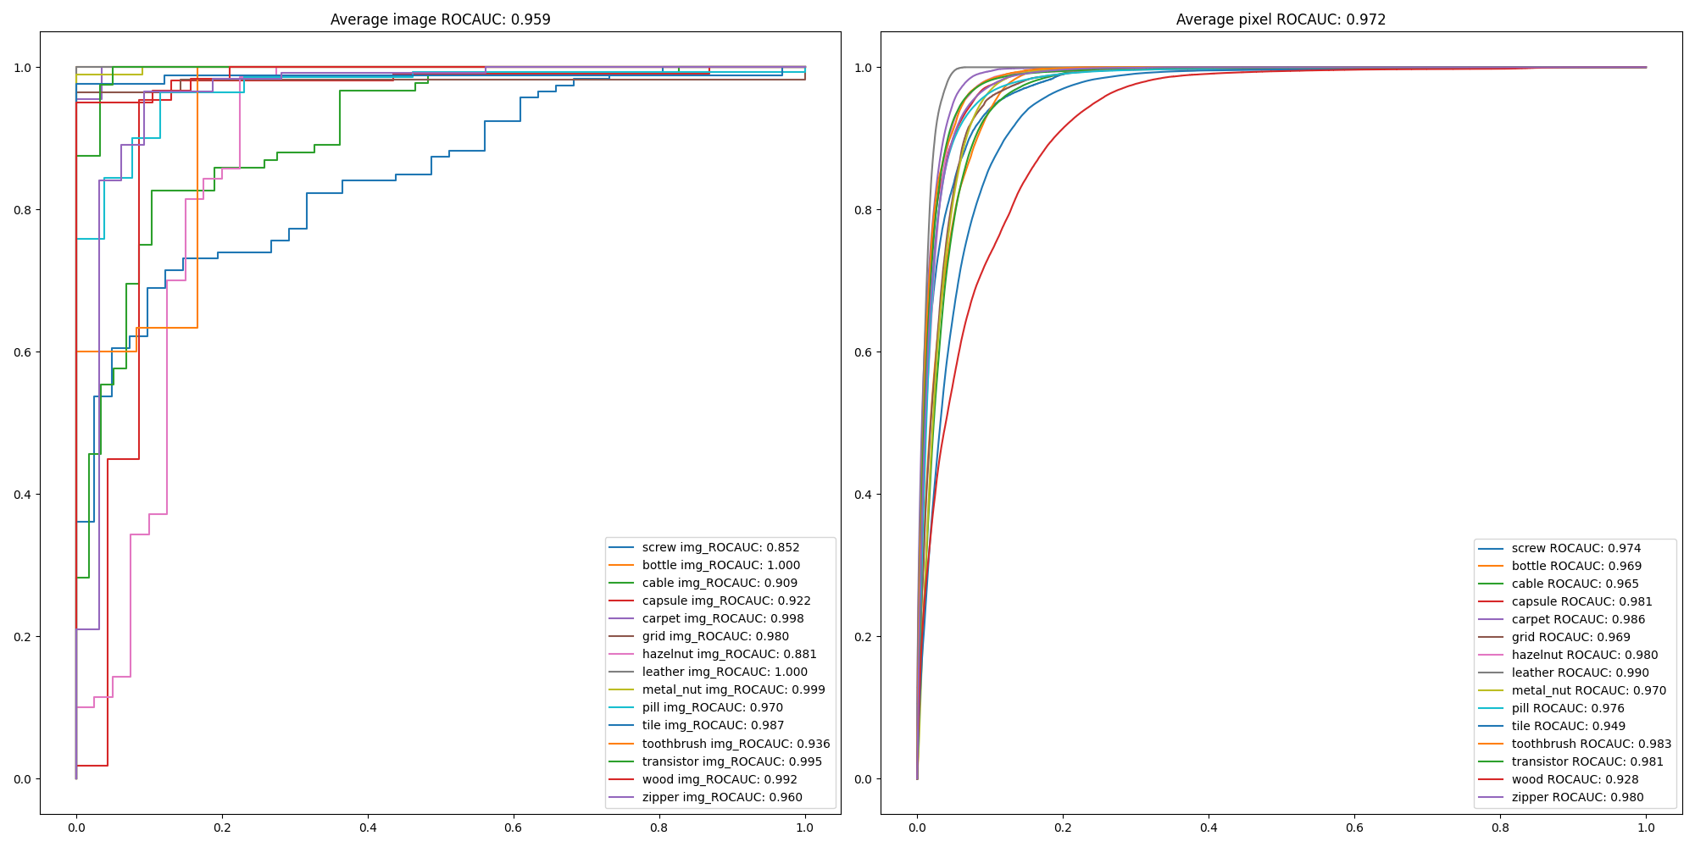
3. Result
Combine architecture(wide_resnet_101, resnext50_32x4d)

Slide 13
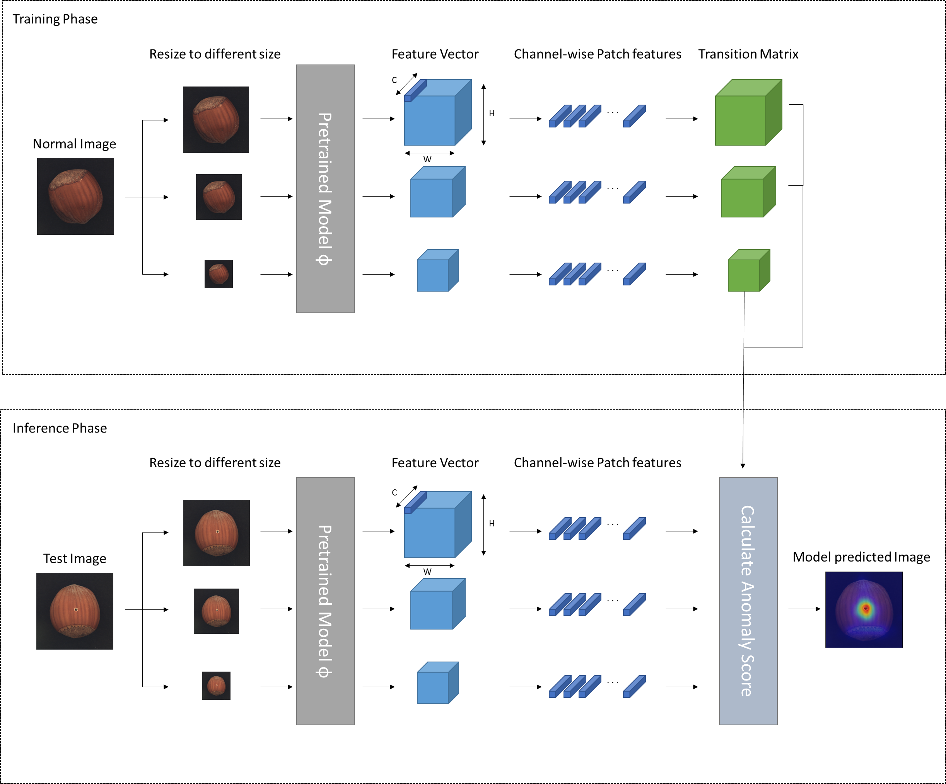
3. Result
Image size FPN

Slide 14
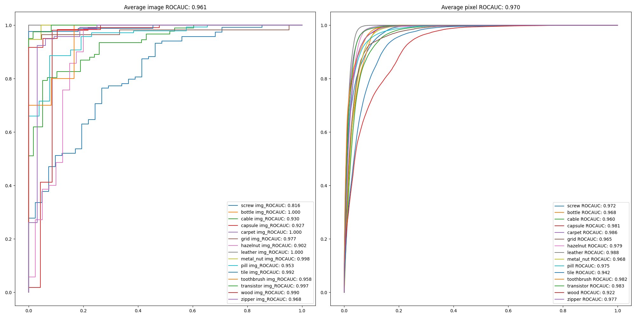
3. Result
Image size FPN (based on 256, and 512, 128, wide_resnet_50)

Slide 15
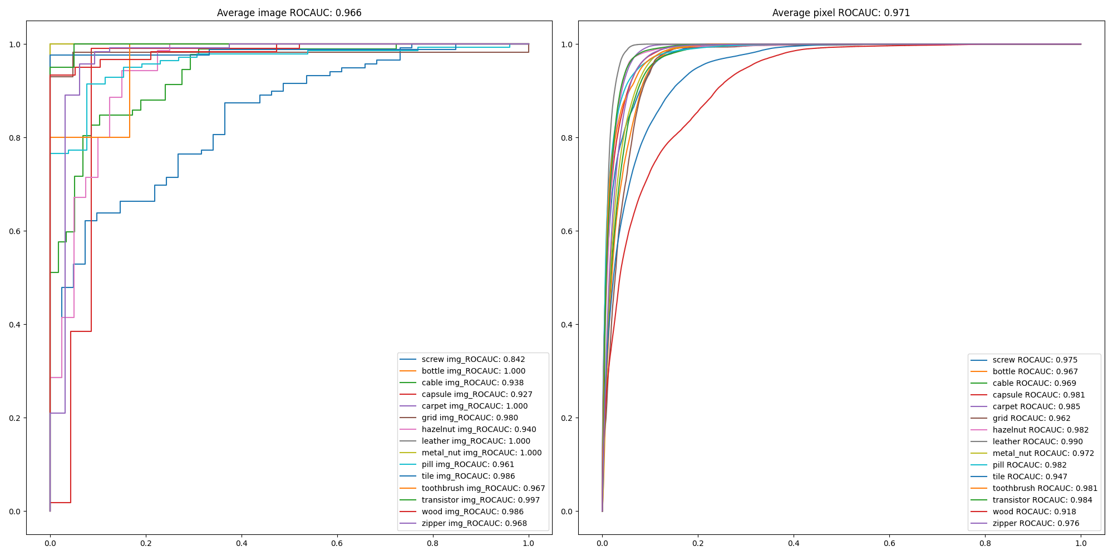
3. Result
Image size FPN (based on 256, and 512, 128, wide_resnet_101)

Slide 16
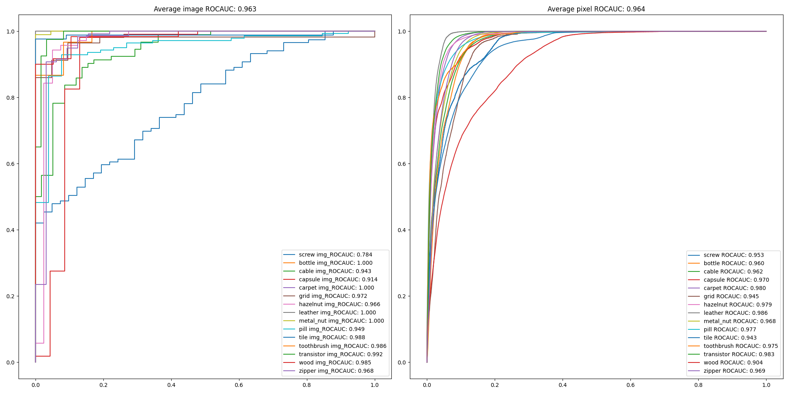
3. Result
Image size FPN (based on 128, and 512, 256, wide_resnet_101)

Slide 17
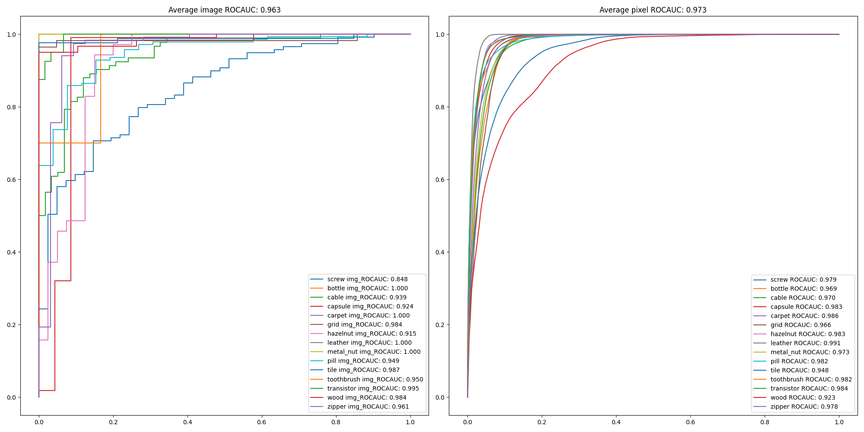
3. Result
Image size FPN (based on 512, and 256, 128, wide_resnet_101)

Slide 18
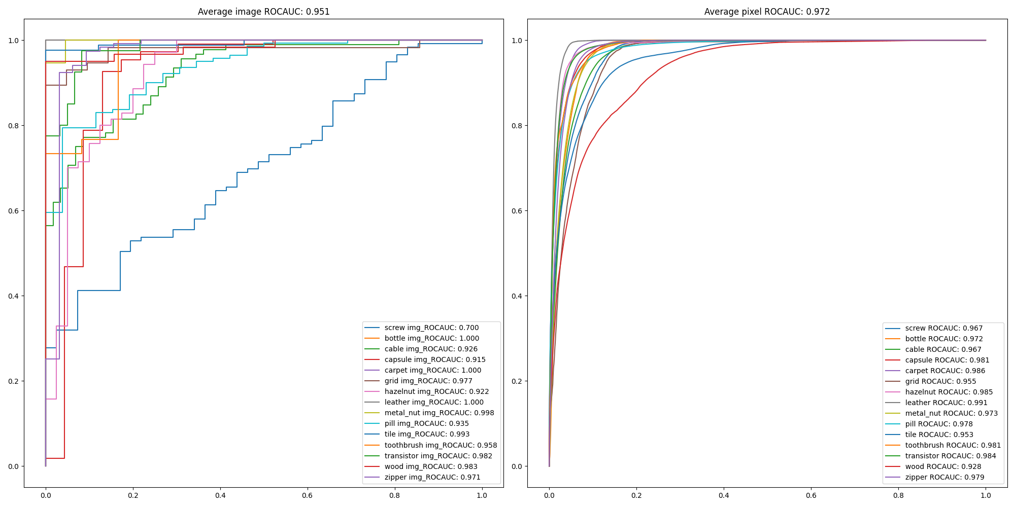
3. Result
Image size FPN (based on 256, and 768, 1024, 512, 128, 64, wide_resnet_101)

Slide 19
Thank you

